Slide 1

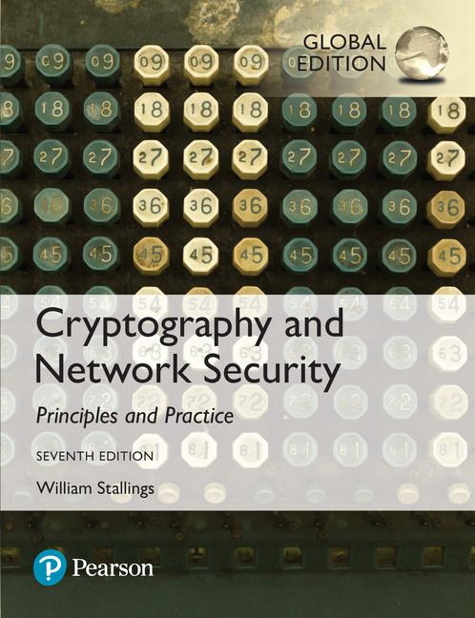

Cryptography and Network Security
Seventh Edition, Global Edition
by William Stallings
Notes:
Lecture slides prepared for “Cryptography and Network Security”, 7/e, by William Stallings, Chapter 4 – “Block Ciphers and the Data Encryption Standard”.

Slide 2
Chapter 4
Symmetric Encryption and the Data Encryption Standard
Notes:
The objective of this chapter is to illustrate the principles of modern symmetric
ciphers. For this purpose, we focus on the most widely used symmetric cipher: the Data
Encryption Standard (DES). Although numerous symmetric ciphers have been developed
since the introduction of DES, and although it is destined to be replaced by the
Advanced Encryption Standard (AES), DES remains the most important such algorithm.
Furthermore, a detailed study of DES provides an understanding of the principles
used in other symmetric ciphers.
This chapter begins with a discussion of the general principles of symmetric block
ciphers, which are the principal type of symmetric ciphers studied in this book. The
other form of symmetric ciphers, stream ciphers, are discussed in Chapter 8. Next, we
cover full DES. Following this look at a specific algorithm, we return to a more general
discussion of block cipher design.
Compared to public-key ciphers, such as RSA, the structure of DES and most
symmetric ciphers is very complex and cannot be explained as easily as RSA and similar
algorithms. Accordingly, the reader may wish to begin with a simplified version of
DES, which is described in Appendix G. This version allows the reader to perform
encryption and decryption by hand and gain a good understanding of the working of
the algorithm details. Classroom experience indicates that a study of this simplified
version enhances understanding of DES.
Several important symmetric block encryption algorithms in current use are based
on a structure referred to as a Feistel block cipher [FEIS73]. For that reason, it is
important to examine the design principles of the Feistel cipher. We begin with a
comparison of stream ciphers and block ciphers. Then we discuss the motivation for
the Feistel block cipher structure. Finally, we discuss some of its implications.

Slide 3
Types of Ciphers
Cryptography
Classical
Modern (Key-based)
Symmetric
Asymmetric
Hash Function
Block
Stream
RSA
Diffie-Hellman
MD5
SHA
DES
AES
RC4
Notes:
Hash function: one way function

Slide 4
Stream Cipher
Encrypts a digital data stream one bit or one byte at a time
Example: RC4
If the cryptographic keystream is random, then this cipher is unbreakable by any means other than acquiring the keystream
Stream ciphers are linear, so the same key both encrypts and decrypts messages.
It must be computationally impractical to predict future portions of the bit stream based on previous portions of the bit stream
Notes:
A block cipher is one in which a block of plaintext is treated as a whole
and used to produce a ciphertext block of equal length. Typically, a block size of
64 or 128 bits is used. As with a stream cipher, the two users share a symmetric
encryption key (Figure 4.1b). Using some of the modes of operation explained
in Chapter 7, a block cipher can be used to achieve the same effect as a stream
cipher.
Far more effort has gone into analyzing block ciphers. In general, they seem
applicable to a broader range of applications than stream ciphers. The vast majority
of network-based symmetric cryptographic applications make use of block
ciphers. Accordingly, the concern in this chapter, and in our discussions throughout
the book of symmetric encryption, will primarily focus on block ciphers.

Slide 5
Block Cipher
A block of plaintext is treated as a whole and used to produce a ciphertext block of equal length
Typically a block size of 64 or 128 bits is used
As with a stream cipher, the two users share a symmetric encryption key
The majority of network-based symmetric cryptographic applications make use of block ciphers
Notes:
A block cipher is one in which a block of plaintext is treated as a whole
and used to produce a ciphertext block of equal length. Typically, a block size of
64 or 128 bits is used. As with a stream cipher, the two users share a symmetric
encryption key (Figure 4.1b). Using some of the modes of operation explained
in Chapter 7, a block cipher can be used to achieve the same effect as a stream
cipher.
Far more effort has gone into analyzing block ciphers. In general, they seem
applicable to a broader range of applications than stream ciphers. The vast majority
of network-based symmetric cryptographic applications make use of block
ciphers. Accordingly, the concern in this chapter, and in our discussions throughout
the book of symmetric encryption, will primarily focus on block ciphers.

Slide 6
 | Stream Cipher | Block Cipher
Length | Bit or Byte | Block of size 64, 128 bits
Design | Complex | Simple
Principle | Confusion | Confusion and Diffusion
Speed | Faster | Slower
Encryption | CFB (Cipher Feedback) and OFB (Output Feedback) | ECB (Electronic Code Book) and CBC (Cipher Block Chaining)
Decryption | XOR | Reverse of Encryption
Example | RC4 | DES, AES
Confusion: making the relationship between the encryption key and the ciphertext as complex as possible (e.g., substitution techniques).
Diffusion: making each plaintext bit affect as many ciphertext bits as possible, thus changing 1 bit of PT make a significant effect on CT (e.g., transposition techniques)
Notes:
Examples of stream and block ciphers.

Slide 7
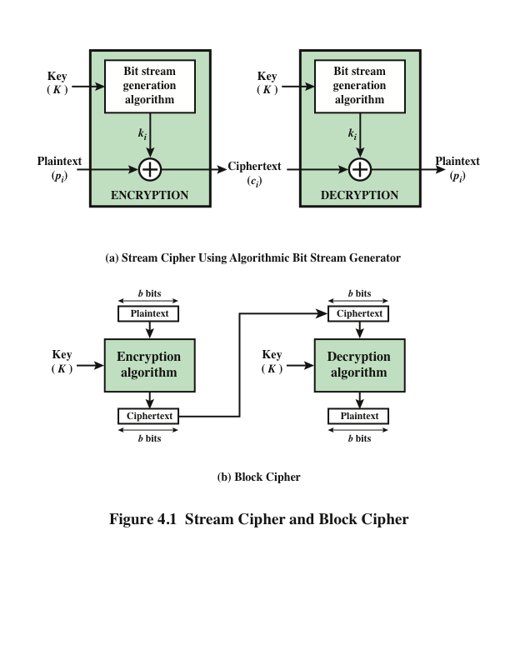
Notes:
Examples of stream and block ciphers.

Slide 8
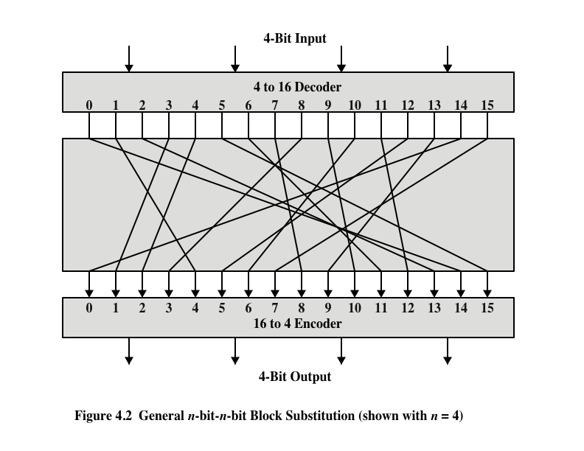
Notes:
A block cipher operates on a plaintext block of n bits to produce a ciphertext
block of n bits. There are 2^{n} possible different plaintext blocks and, for the
encryption to be reversible (i.e., for decryption to be possible), each must produce
a unique ciphertext block. Such a transformation is called reversible, or nonsingular.
Figure 4.2 illustrates the logic of a general substitution cipher for n = 4.
A 4-bit input produces one of 2⁴ =16 possible input states, which is mapped by the substitution
cipher into a unique one of 16 possible output states, each of which is represented
by 4 ciphertext bits.

Slide 9
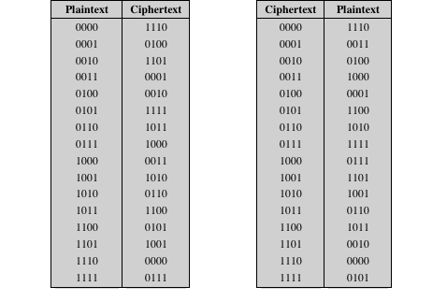
Tables for Substitution Cipher of Figure 4.2
Notes:
The encryption and decryption mappings can be defined
by a tabulation, as shown in Table 4.1. This is the most general form of block cipher
and can be used to define any reversible mapping between plaintext and ciphertext.
Feistel refers to this as the ((ideal block cipher)) , because it allows for the maximum
number of possible encryption mappings from the plaintext block [FEIS75].

Slide 10
Feistel Cipher
Feistel proposed the use of a cipher that alternates substitutions and permutations
Is a practical application of a proposal by Claude Shannon to develop a product cipher that alternates confusion and diffusion functions
the structure used by many significant symmetric block ciphers currently in use
Substitutions
Each plaintext element or group of elements is uniquely replaced by a corresponding ciphertext element or group of elements
Permutation
No elements are added or deleted or replaced in the sequence, rather the order in which the elements appear in the sequence is changed
Notes:
Feistel cipher is symmetric structure used for block ciphering. Feistel proposed [FEIS73] that we can approximate the ideal block cipher by utilizing
the concept of a product cipher, which is the execution of two or more simple ciphers
in sequence in such a way that the final result or product is cryptographically stronger
than any of the component ciphers.
The essence of the approach is to develop a block cipher with a key length of k bits and a block length of n bits, allowing a total of 2^{k}
possible transformations, rather than the 2^{n} ! transformations available with the ideal block cipher.
In particular, Feistel proposed the use of a cipher that alternates substitutions and permutations, where these terms are defined as follows:
• Substitution: Each plaintext element or group of elements is uniquely replaced by a corresponding ciphertext element or group of elements (e.g., car→ DLN)
• Permutation: A sequence of plaintext elements is replaced by a permutation of that sequence. That is, no elements are added or deleted or replaced in the
sequence, rather the order in which the elements appear in the sequence is changed. (e.g., Car→ arc)
In fact, Feistel’s is a practical application of a proposal by Claude Shannon
to develop a product cipher that alternates confusion and diffusion functions
[SHAN49]. We look next at these concepts of diffusion and confusion and then
present the Feistel cipher. But first, it is worth commenting on this remarkable fact:
The Feistel cipher structure, which dates back over a quarter century and which, in
turn, is based on Shannon’s proposal of 1945, is the structure used by many significant
symmetric block ciphers currently in use.
In particular, the Feistel structure
is used for Triple Data Encryption Algorithm (TDEA), which is one of the two
encryption algorithms (along with AES), approved for general use by the National
Institute of Standards and Technology (NIST). The Feistel structure is also used for
several schemes for format-preserving encryption, which have recently come into
prominence. In addition, the Camellia block cipher is a Feistel structure; it is one
of the possible symmetric ciphers in TLS and a number of other Internet security
protocols. Both TDEA and format-preserving encryption are covered in Chapter 7.

Slide 11
Diffusion and Confusion
Terms introduced by Claude Shannon to capture the two basic building blocks for any cryptographic system
Shannon’s concern was to thwart cryptanalysis based on statistical analysis
Diffusion
This is achieved by having each plaintext digit affect the value of many ciphertext digits
Confusion
Seeks to make the relationship between the statistics of the ciphertext and the value of the encryption key as complex as possible
Even if the attacker can get some handle on the statistics of the ciphertext, the way in which the key was used to produce that ciphertext is so complex as to make it difficult to deduce the key
Notes:
The terms diffusion and confusion were introduced by
Claude Shannon to capture the two basic building blocks for any cryptographic
system [SHAN49]. Shannon’s concern was to thwart cryptanalysis based on statistical
analysis. The reasoning is as follows. Assume the attacker has some knowledge
of the statistical characteristics of the plaintext. For example, in a human-readable
message in some language, the frequency distribution of the various letters may be
known. Or there may be words or phrases likely to appear in the message (probable
words). If these statistics are in any way reflected in the ciphertext, the cryptanalyst
may be able to deduce the encryption key, part of the key, or at least a set of keys
likely to contain the exact key. In what Shannon refers to as a strongly ideal cipher,
all statistics of the ciphertext are independent of the particular key used. The arbitrary
substitution cipher that we discussed previously (Figure 4.2) is such a cipher,
but as we have seen, it is impractical.
Other than recourse to ideal systems, Shannon suggests two methods for
frustrating statistical cryptanalysis: diffusion and confusion. In diffusion , the
statistical structure of the plaintext is dissipated into long-range statistics of the
ciphertext. This is achieved by having each plaintext digit affect the value of many
ciphertext digits; generally, this is equivalent to having each ciphertext digit be
affected by many plaintext digits.
Every block cipher involves a transformation of a block of plaintext into a
block of ciphertext, where the transformation depends on the key. The mechanism
of diffusion seeks to make the statistical relationship between the plaintext and
ciphertext as complex as possible in order to thwart attempts to deduce the key. On
the other hand, confusion seeks to make the relationship between the statistics of
the ciphertext and the value of the encryption key as complex as possible, again to
thwart attempts to discover the key. Thus, even if the attacker can get some handle
on the statistics of the ciphertext, the way in which the key was used to produce that
ciphertext is so complex as to make it difficult to deduce the key. This is achieved by
the use of a complex substitution algorithm. In contrast, a simple linear substitution
function would add little confusion.
As [ROBS95b] points out, so successful are diffusion and confusion in capturing
the essence of the desired attributes of a block cipher that they have become the
cornerstone of modern block cipher design.

Slide 12
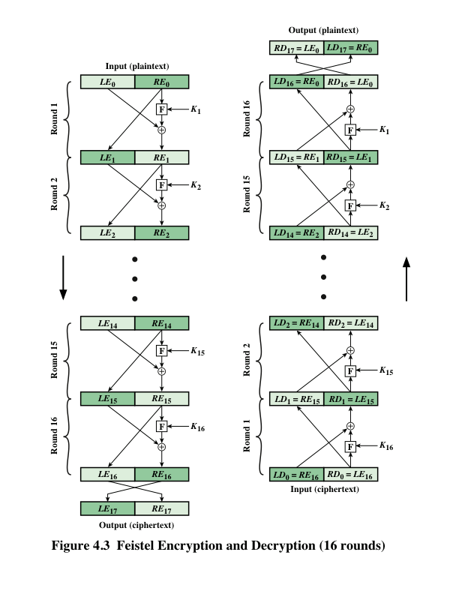
Notes:
The left-hand side of Figure 4.3 depicts the structure
proposed by Feistel. The inputs to the encryption algorithm are a plaintext block of
length 2w bits and a key K . The plaintext block is divided into two halves, LE₀ and RE₀ .
The two halves of the data pass through n rounds of processing and then combine to
produce the ciphertext block. Each round i has as inputs LE_{i-1} and RE_{i-1} derived from
the previous round, as well as a subkey K_{i} derived from the overall K . In general,
the subkeys K_{i} are different from K and from each other. In Figure 4.3, 16 rounds
are used, although any number of rounds could be implemented.
All rounds have the same structure. A substitution is performed on the left half
of the data. This is done by applying a round function F to the right half of the data
and then taking the exclusive-OR of the output of that function and the left half of the
data. The round function has the same general structure for each round but is parameterized
by the round subkey K_{i} . Another way to express this is to say that F is a function
of right-half block of w bits and a subkey of y bits, which produces an output value
of length w bits: F (RE_{i} , K_{i+1} ). Following this substitution, a permutation is performed
that consists of the interchange of the two halves of the data. This structure is a particular
form of the substitution-permutation network (SPN) proposed by Shannon.

Slide 13
Feistel Cipher Design Features
Block size
Larger block sizes mean greater security but reduced encryption/decryption speed for a given algorithm
Key size
Larger key size means greater security but may decrease encryption/decryption speeds
Number of rounds
The essence of the Feistel cipher is that a single round offers inadequate security but that multiple rounds offer increasing security
Subkey generation algorithm
Greater complexity in this algorithm should lead to greater difficulty of cryptanalysis
Round function F
Greater complexity generally means greater resistance to cryptanalysis
Fast software encryption/decryption
In many cases, encrypting is embedded in applications or utility functions in such a way as to preclude a hardware implementation; accordingly, the speed of execution of the algorithm becomes a concern
Ease of analysis
If the algorithm can be clearly explained, it is easier to analyze that algorithm for cryptanalytic vulnerabilities and therefore develop a higher level of assurance as to its strength
Notes:
The exact realization of a Feistel network depends on the choice of the following
parameters and design features:
• Block size: Larger block sizes mean greater security (all other things being
equal) but reduced encryption/decryption speed for a given algorithm. The
greater security is achieved by greater diffusion. Traditionally, a block size of
64 bits has been considered a reasonable tradeoff and was nearly universal in
block cipher design. However, the new AES uses a 128-bit block size.
• Key size: Larger key size means greater security but may decrease encryption/
decryption speed. The greater security is achieved by greater resistance to
brute-force attacks and greater confusion. Key sizes of 64 bits or less are now
widely considered to be inadequate, and 128 bits has become a common size.
• Number of rounds: The essence of the Feistel cipher is that a single round
offers inadequate security but that multiple rounds offer increasing security.
A typical size is 16 rounds.
• Subkey generation algorithm: Greater complexity in this algorithm should
lead to greater difficulty of cryptanalysis.
• Round function F: Again, greater complexity generally means greater resistance
to cryptanalysis.
There are two other considerations in the design of a Feistel cipher:
• Fast software encryption/decryption: In many cases, encryption is embedded in
applications or utility functions in such a way as to preclude a hardware implementation.
Accordingly, the speed of execution of the algorithm becomes a
concern.
• Ease of analysis: Although we would like to make our algorithm as difficult as
possible to cryptanalyze, there is great benefit in making the algorithm easy to
analyze. That is, if the algorithm can be concisely and clearly explained, it is
easier to analyze that algorithm for cryptanalytic vulnerabilities and therefore
develop a higher level of assurance as to its strength. DES, for example, does
not have an easily analyzed functionality.

Slide 14
Block Cipher Design Principles: Number of Rounds
The greater the number of rounds, the more difficult it is to perform cryptanalysis
In general, the criterion should be that the number of rounds is chosen so that known cryptanalytic efforts require greater effort than a simple brute-force key search attack
If DES had 15 or fewer rounds, differential cryptanalysis would require less effort than a brute-force key search attack
Notes:
The cryptographic strength of a Feistel cipher derives from three aspects of the
design: the number of rounds, the function F, and the key schedule algorithm. Let
us look first at the choice of the number of rounds.
The greater the number of rounds, the more difficult it is to perform cryptanalysis,
even for a relatively weak F. In general, the criterion should be that the
number of rounds is chosen so that known cryptanalytic efforts require greater
effort than a simple brute-force key search attack. This criterion was certainly used
in the design of DES. Schneier [SCHN96] observes that for 16-round DES, a differential
cryptanalysis attack is slightly less efficient than brute force: The differential
cryptanalysis attack requires 2^{55.1} operations, whereas brute force requires 2⁵⁵ . If
DES had 15 or fewer rounds, differential cryptanalysis would require less effort
than a brute-force key search.
This criterion is attractive, because it makes it easy to judge the strength of
an algorithm and to compare different algorithms. In the absence of a cryptanalytic
breakthrough, the strength of any algorithm that satisfies the criterion can be
judged solely on key length.

Slide 15
Block Cipher Design Principles: Key Generation Algorithm
With any Feistel block cipher, the key is used to generate one subkey for each round
In general, we would like to select subkeys to maximize the difficulty of deducing individual subkeys and the difficulty of working back to the main key
It is suggested that, at a minimum, the key schedule should guarantee key/ciphertext Strict Avalanche Criterion (SAC: if an input is changed slightly, the output changes significantly) and Bit Independence Criterion (BIC: output bits should change independently when any single input bit is inverted)
Notes:
With any Feistel block cipher, the key is used to generate one subkey for each
round. In general, we would like to select subkeys to maximize the difficulty of
deducing individual subkeys and the difficulty of working back to the main key. No
general principles for this have yet been promulgated.
Adams suggests [ADAM94] that, at minimum, the key schedule should
guarantee key/ciphertext Strict Avalanche Criterion and Bit Independence
Criterion.
The bit independence criterion was proposed to evaluate the security of the S-boxes used in block ciphers.

Slide 16
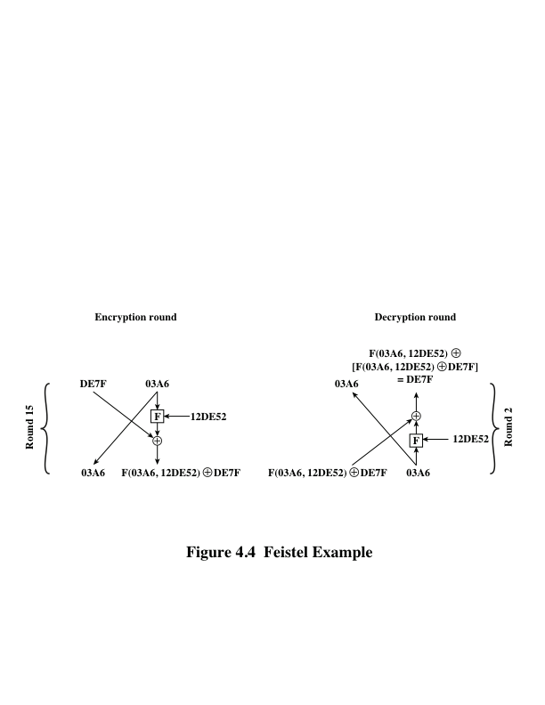
Feistel Example
Notes:
The process of decryption with a Feistel cipher
is essentially the same as the encryption process. The rule is as follows: Use the
ciphertext as input to the algorithm, but use the subkeys K_{i} in reverse order. That
is, use K_{n} in the first round, K_{n-1} in the second round, and so on, until K₁ is used in
the last round. This is a nice feature, because it means we need not implement two
different algorithms; one for encryption and one for decryption.

Slide 17
Data Encryption Standard (DES)
DES is based on the Feistel block cipher, called LUCIFER, developed in 1971 by IBM cryptography researcher Horst Feistel.
DES uses 16 rounds of the Feistel structure, using a different key for each round.
DES became the approved federal encryption standard in November 1976
Was the most widely used encryption scheme until the introduction of the Advanced Encryption Standard (AES) in 2005
Algorithm itself is referred to as the Data Encryption Algorithm (DEA)
Data are encrypted in 64-bit blocks using a 56-bit key
The algorithm transforms 64-bit input in a series of steps into a 64-bit output
The same steps, with the same key, are used to reverse the encryption
Notes:
Until the introduction of the Advanced Encryption Standard (AES) in 2001, the
Data Encryption Standard (DES) was the most widely used encryption scheme.
DES was issued in 1977 by the National Bureau of Standards, now the National
Institute of Standards and Technology (NIST), as Federal Information Processing
Standard 46 (FIPS PUB 46). The algorithm itself is referred to as the Data
Encryption Algorithm (DEA). For DEA, data are encrypted in 64-bit blocks using
a 56-bit key. The algorithm transforms 64-bit input in a series of steps into a 64-bit
output. The same steps, with the same key, are used to reverse the encryption.
Over the years, DES became the dominant symmetric encryption algorithm,
especially in financial applications. In 1994, NIST reaffirmed DES for federal use
for another five years; NIST recommended the use of DES for applications other
than the protection of classified information. In 1999, NIST issued a new version
of its standard (FIPS PUB 46-3) that indicated that DES should be used only for
legacy systems and that triple DES (which in essence involves repeating the DES
algorithm three times on the plaintext using two or three different keys to produce
the ciphertext) be used. We study triple DES in Chapter 7. Because the underlying
encryption and decryption algorithms are the same for DES and triple DES, it
remains important to understand the DES cipher. This section provides an overview.
For the interested reader, Appendix S provides further detail.

Slide 18
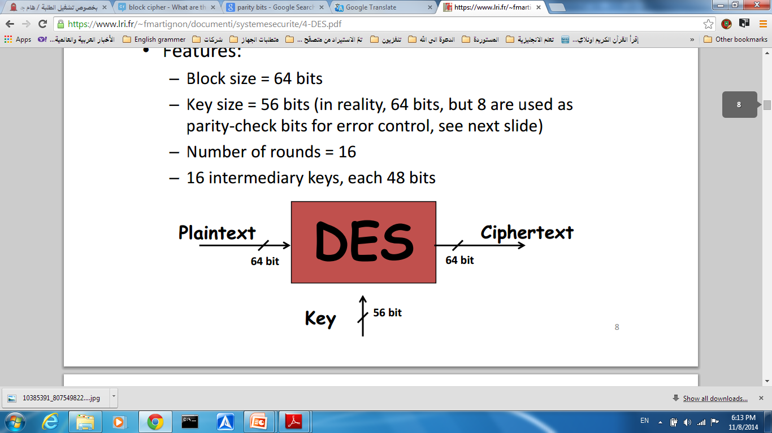
DES Features
Block size = 64 bits
Key size = 56 bits (in reality, 64 bits, but 8 are used as parity-check bits for error control, see next slide)
Number of rounds = 16
16 intermediary keys, each 48 bits

Slide 19
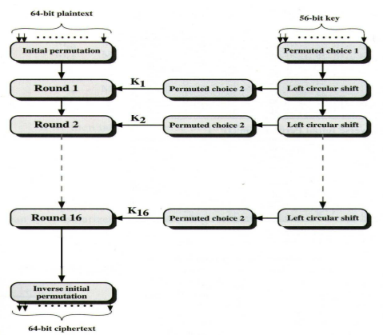
DES Encryption Algorithm
Notes:
The overall scheme for DES encryption is illustrated in Figure 3.5. As with any encryption
scheme, there are two inputs to the encryption function: the plaintext to be
encrypted and the key. In this case, the plaintext must be 64 bits in length and the
key is 56 bits in length.
Looking at the left-hand side of the figure, we can see that the processing
of the plaintext proceeds in three phases. First, the 64-bit plaintext passes through
an initial permutation (IP) that rearranges the bits to produce the permuted input .
This is followed by a phase consisting of sixteen rounds of the same function, which
involves both permutation and substitution functions. The output of the last (sixteenth)
round consists of 64 bits that are a function of the input plaintext and the
key. The left and right halves of the output are swapped to produce the preoutput .
Finally, the preoutput is passed through a permutation [IP ⁻¹ ] that is the inverse of
the initial permutation function, to produce the 64-bit ciphertext. With the exception
of the initial and final permutations, DES has the exact structure of a Feistel
cipher, as shown in Figure 3.3.
The right-hand portion of Figure 3.5 shows the way in which the 56-bit key is
used. Initially, the key is passed through a permutation function. Then, for each of
the sixteen rounds, a subkey (K_{i} ) is produced by the combination of a left circular
shift and a permutation. The permutation function is the same for each round, but a
different subkey is produced because of the repeated shifts of the key bits.
As with any Feistel cipher, decryption uses the same algorithm as encryption,
except that the application of the subkeys is reversed. Additionally, the initial and
final permutations are reversed.

Slide 20
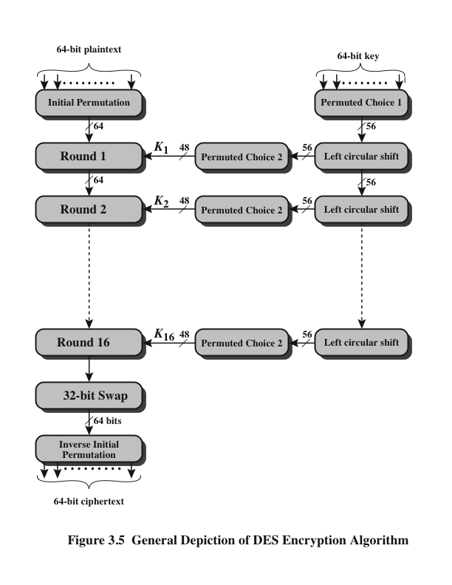
Description of DES
The left side shows the basic process for enciphering a 64-bit data block which consists of:
an initial permutation (IP) which shuffles the 64-bit input block
16 rounds of a complex key dependent round function involving substitutions & permutations
Swap left and right
a final permutation, being the inverse of IP

Slide 21
Description of DES
The right side shows the handling of the 56-bit key and consists of:
an initial permutation of the key (PC1) which selects 56-bits out of the 64-bits input, in two 28-bit halves
16 stages to generate the 48-bit subkeys using a left circular shift and a permutation of the two 28-bit halves

Slide 22
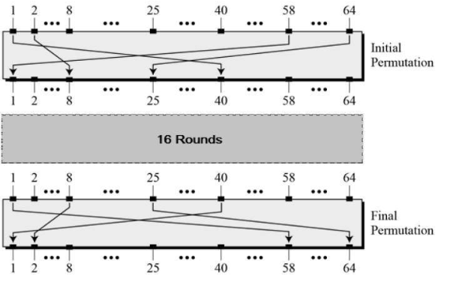
Notes:
The overall scheme for DES encryption is illustrated in Figure 4.5. As with any encryption
scheme, there are two inputs to the encryption function: the plaintext to be
encrypted and the key. In this case, the plaintext must be 64 bits in length and the
key is 56 bits in length.
Looking at the left-hand side of the figure, we can see that the processing
of the plaintext proceeds in three phases. First, the 64-bit plaintext passes through
an initial permutation (IP) that rearranges the bits to produce the permuted input .
This is followed by a phase consisting of sixteen rounds of the same function, which
involves both permutation and substitution functions. The output of the last (sixteenth)
round consists of 64 bits that are a function of the input plaintext and the
key. The left and right halves of the output are swapped to produce the preoutput .
Finally, the preoutput is passed through a permutation [IP ⁻¹ ] that is the inverse of
the initial permutation function, to produce the 64-bit ciphertext. With the exception
of the initial and final permutations, DES has the exact structure of a Feistel
cipher, as shown in Figure 4.3.
The right-hand portion of Figure 4.5 shows the way in which the 56-bit key is
used. Initially, the key is passed through a permutation function. Then, for each of
the sixteen rounds, a subkey (K_{i} ) is produced by the combination of a left circular
shift and a permutation. The permutation function is the same for each round, but a
different subkey is produced because of the repeated shifts of the key bits.
As with any Feistel cipher, decryption uses the same algorithm as encryption,
except that the application of the subkeys is reversed. Additionally, the initial and
final permutations are reversed.

Slide 23
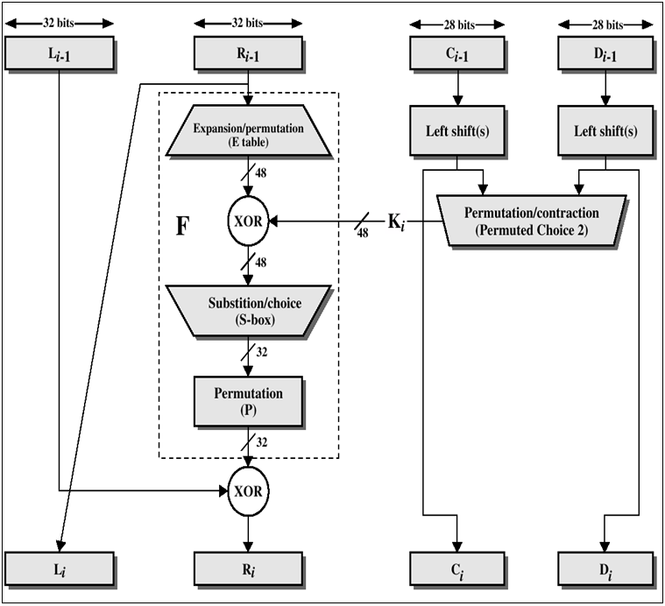
View of a Single Round
Notes:
Stallings Fig 3.5
Note that the s-boxes provide the “confusion” of data and key values, whilst the permutation P then spreads this as widely as possible, so each S-box output affects as many S-box inputs in the next round as possible, giving “diffusion”.
Dashed box (F) is not a permutation of the input 32 bits; it is complex crud that gets added in L_{i-1}.
Each half of the block is modified in this way 8 times total.

Slide 24
Single Round in Words
uses two 32-bit L & R halves
as for any Feistel cipher can describe as:
L_{i} = R_{i–1}
R_{i} = L_{i–1} ⊕ F(R_{i–1}, K_{i})
F takes 32-bit R half and 48-bit subkey:
1- Expands R to 48-bits using perm E (duplication using table that defines permutation plus expansion)
2- Adds to subkey using XOR
3- Passes through 8 S-boxes to get 32-bit result
4- Finally permutes using 32-bit perm P
Notes:
Detail here the internal structure of the DES round function F, which takes R half & subkey, and processes them through E, add subkey, S & P.
This follows the classic structure for a feistel cipher.
Note that the s-boxes provide the “confusion” of data and key values, whilst the permutation P then spreads this as widely as possible, so each S-box output affects as many S-box inputs in the next round as possible, giving “diffusion”.

Slide 25
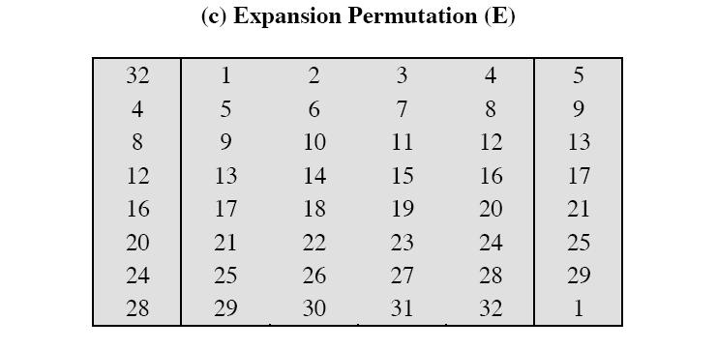
Expansion Function
expansion function which takes a block of 32 bits as input and produces a block of 48 bits as output

Slide 26
Substitution Boxes S
Eight S-boxes which map 6 to 4 bits (8 x 6 = 48)
S = matrix 4x16, values from 0 to 15.
Outer bits 1 & 6 (row bits) select one row of 4 possible 4-bit permutations .
inner bits 2-5 (col bits) are substituted
C (4 bit long) = Binary representation of S(r, c)
Example : in S1 for input 011001 (6 bit for each box)
011001 = (01) = row one in decimal
011001 = 1100 = 12 in decimal
The value in row 1 and col 12 is (9) taken and represented in binary and considered as output (1001)
Notes:
The substitution consists of a set of eight S-boxes, each of which accepts 6 bits as input and produces 4 bits as output. These transformations are defined in Stallings Table 3.3, which is interpreted as follows:
The first and last bits of the input to box Si form a 2-bit binary number to select one of four substitutions defined by the four rows in the table for Si.
The middle four bits select one of the sixteen columns.
The decimal value in the cell selected by the row and column is then converted to its 4-bit representation to produce the output.
For example, in S1, for input 011001, the row is 01 (row 1) and the column is 1100 (column 12). The value in row 1, column 12 is 9, so the output is 1001.
The example lists 8
6-bit values (ie 18 in hex is 011000 in binary, 09 hex is 001001 binary, 12 hex is 010010 binary, 3d hex is 111101 binary etc),
each of which is replaced following the process detailed above using the appropriate S-box. ie
S1(011000) lookup row 00 col 1100 in S1 to get 5
S2(001001) lookup row 01 col 0100 in S2 to get 15 = f in hex
S3(010010) lookup row 00 col 1001 in S3 to get 13 = d in hex
S4(111101) lookup row 11 col 1110 in S4 to get 2 etc

Slide 27
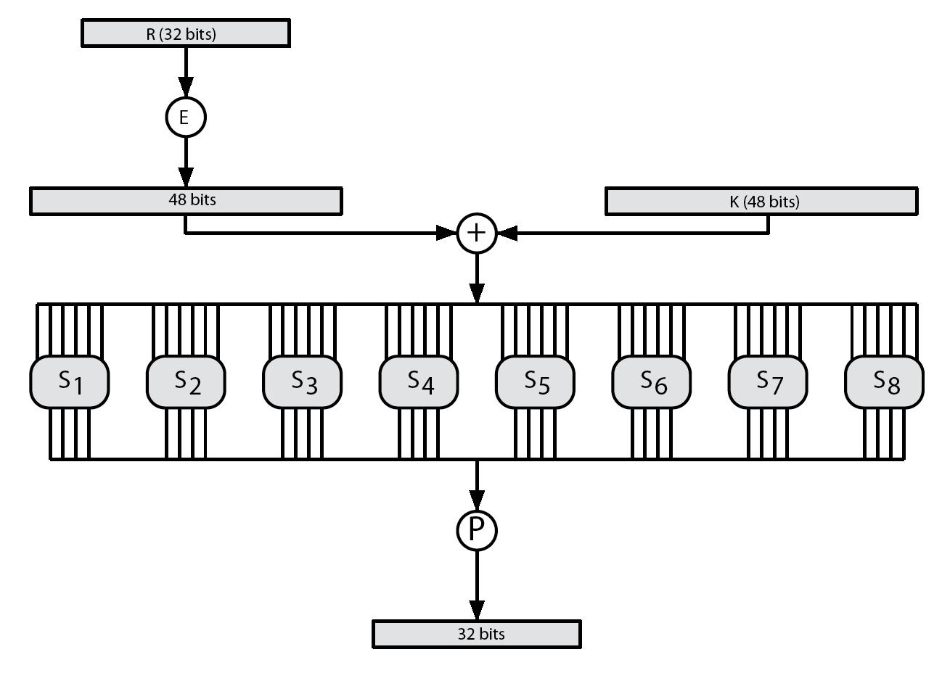
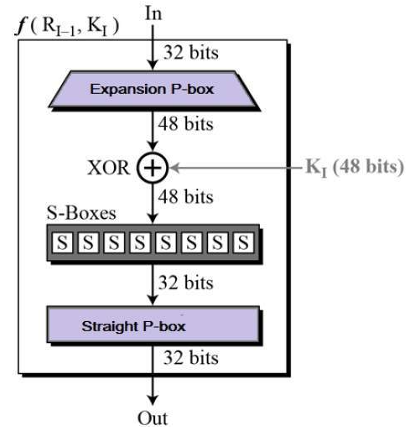
DES Round Function F
Notes:
Stallings Figure 3.6 illustrates the internal structure of the DES round function F.
The R input is first expanded to 48 bits by using expansion table E that defines a permutation plus an expansion that involves duplication of 16 of the R bits (Stallings Table 3.2c). The resulting 48 bits are XORed with Ki. This 48-bit result passes through a substitution function comprising 8 S-boxes which each map 6 input bits to 4 output bits, producing a 32-bit output, which is then permuted by permutation P as defined by Stallings Table 3.2d.

Slide 28
DES algorithm
Example: Let K be the hexadecimal key K = 133457799BBCDFF1. This gives us as the binary key (setting 1 = 0001, 3 = 0011, etc., and grouping together every eight bits, of which the last one in each group will be unused):
K = 0001 0011 0011 0100 0101 0111 0111 1001 1001 1011 1011 1100 1101 1111 1111 0001

Slide 29
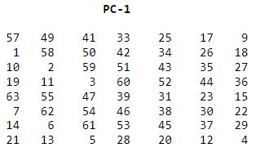
DES algorithm
The DES algorithm uses the following steps:
Stage 1: Create 16 subkeys, each of which is 48-bits long.
(1). Permute the given key using the permutation choice 1: the 64-bit key is permuted according to the following table, PC-1 into 56bit. Since the first entry in the table is "57", this means that the 57th bit of the original key K becomes the first bit of the permuted key K+.

Slide 30
DES algorithm
K =
0001 0011 0011 0100 0101 0111 0111 1001 1001 1011 1011 1100 1101 1111 1111 0001
K+ = 1

Slide 31
DES algorithm
K =
0001 0011 0011 0100 0101 0111 0111 1001 1001 1011 1011 1100 1101 1111 1111 0001
K+ = 11

Slide 32
DES algorithm
K =
0001 0011 0011 0100 0101 0111 0111 1001 1001 1011 1011 1100 1101 1111 1111 0001
K+ = 1111 0000 1100 1100 1010 1010 1111 0101 0101 0110 0110 0111 1000 1111

Slide 33
DES algorithm
Split the key into 2 halves:
Using the obtained 56-bit permutation, split this key into left and right halves, C₀ and D₀, where each half has 28 bits.
K+ = 1111 0000 1100 1100 1010 1010 1111 0101 0101 0110 0110 0111 1000 1111
C₀ = 1111 0000 1100 1100 1010 1010 1111 D₀ = 0101 0101 0110 0110 0111 1000 1111

Slide 34
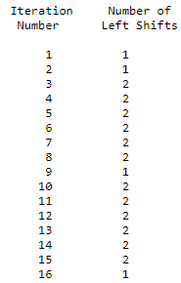
DES algorithm
(2). Apply Circular Left Shift on each half:
Using C₀ and D₀, create sixteen sub-keys C_{n} and D_{n}, 1<=n<=16. Each pair of C_{n} and D_{n} is formed from the previous pair C_{n-1} and D_{n-1}, respectively.
For n = 1, 2, ..., 16, using the following schedule of "left shifts" of the previous block by moving each bit one place to the left, except for the first bit, which is cycled to the end of the block.

Slide 35
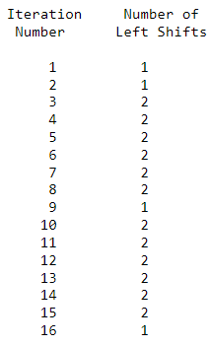
DES algorithm
C₀ = 1111 0000 1100 1100 1010 1010 1111 D₀ =0101 0101 0110 0110 0111 1000 1111
C₁ = 1110 0001 1001 1001 0101 0101 1111 D₁ =1010 1010 1100 1100 1111 0001 1110
C₂ = 1100 0011 0011 0010 1010 1011 1111 D₂ =0101 0101 1001 1001 1110 0011 1101
C₃ = 0000 1100 1100 1010 1010 1111 1111 D₃ = 0101 0110 0110 0111 1000 1111 0101
…
C₁₆ = 1111 0000 1100 1100 1010 1010 1111 D₁₆ =0101 0101 0110 0110 0111 1000 1111

Slide 36
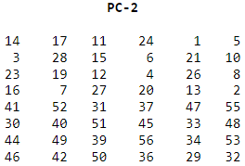
DES algorithm
Concatenate left (C) and right (D) of each sub-key.
(3). Permute each key using the permutation Choice 2: apply second permutation to each of the concatenated pairs C_{n}D_{n} using the following permutation table. Each pair has 56 bits, but PC-2 only uses 48 of these.
For example: For the first key we have C₁D₁ =
1110 0001 1001 1001 0101 0101 1111 1010 1010 1100 1100 1111 0001 1110
which, after we apply the permutation PC-2, becomes
K₁ =
00011011 00000010 11101111 11111100 01110000 01110010
Do the same to get the other keys

Slide 37
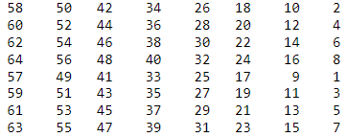
DES algorithm
Stage 2: Encode each 64-bit block of plaintext.
(1). Apply an initial permutation IP of the 64 bits of the message data M using the following IP table.
Example: Applying the initial permutation to the block of text M = 0123456789ABCDEF
M = 0000 0001 0010 0011 0100 0101 0110 0111 1000 1001 1010 1011 1100 1101 1110 1111 IP = 1100 1100 0000 0000 1100 1100 1111 1111 1111 0000 1010 1010 1111 0000 1010 1010

Slide 38
DES algorithm
IP = 1100 1100 0000 0000 1100 1100 1111 1111 1111 0000 1010 1010 1111 0000 1010 1010
(2). Divide IP into L₀ and R₀, and proceed through 16 iterations, for 1<=n<=16, using a function f:
L₀ = 1100 1100 0000 0000 1100 1100 1111 1111 R₀ = 1111 0000 1010 1010 1111 0000 1010 1010
Let + denote XOR addition, (bit-by-bit addition modulo 2). Then for n going from 1 to 16 we calculate:
L_{n} = R_{n-1} R_{n} = L_{n-1} + f(R_{n-1},K_{n})

Slide 39
DES algorithm
L₀ = 1100 1100 0000 0000 1100 1100 1111 1111 R₀ = 1111 0000 1010 1010 1111 0000 1010 1010
For example: For n = 1, we have
K₁ = 0001 1011 0000 0010 1110 1111 1111 1100 0111 0000 0111 0010 L₁ = R₀ = 1111 0000 1010 1010 1111 0000 1010 1010 R₁ = L₀ + f(R₀,K₁)

Slide 40
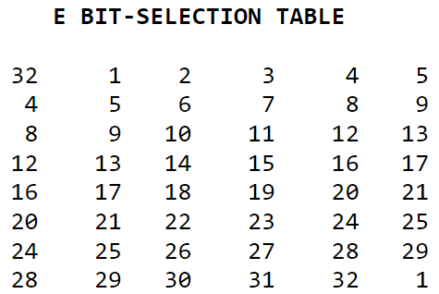
DES algorithm
(3). Expand each block R_{n-1} from 32 bits to 48 bits (as key length): This is done by using a 8x6 selection table that repeats some of the bits in R_{n-1} .
For example: We calculate E(R₀) from R₀ as follows:
R₀ = 1111 0000 1010 1010 1111 0000 1010 1010 E(R₀) = 011110 100001 010101 010101 011110 100001 010101 010101

Slide 41
DES algorithm
(4). Calculate f by performing XOR the output E(R_{n-1}) with the key K_{n}:
K₁ = 0001 1011 0000 0010 1110 11 11 1111 1100 0111 0000 0111 0010 E(R₀) = 01 11 1010 0001 0101 0101 0101 0111 1010 0001 0101 0101 0101
------------------------------------------------------------------------------------------------------
K₁+E(R₀) =0110 0001 0001 01 11 1011 1010 1000 0110 0110 0101 001 00111
Notes:
Decryption is simply the inverse of encryption, follwing the same steps as above, but reversing the order in which the subkeys are applied.

Slide 42
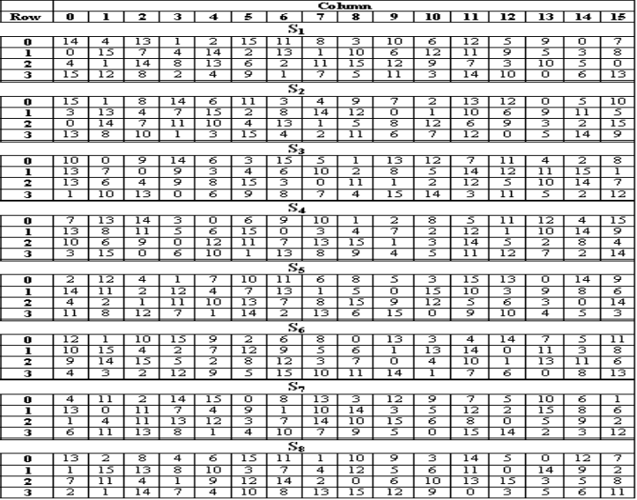
DES algorithm
(5). Apply S-Box choice on the output of the previous step to return the output from 48bits→ 32 bits
011000 010001 011110 111010 100001 100110 010100 100111
Notes:
Decryption is simply the inverse of encryption, following the same steps as above, but reversing the order in which the subkeys are applied.

Slide 43
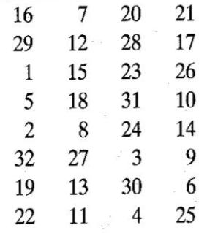
DES algorithm
(6). Permutation choice (P-Box)
(7). XOR the resulted 32 bits with L_{n-1} to obtain the final R_{n}
Notes:
Decryption is simply the inverse of encryption, following the same steps as above, but reversing the order in which the subkeys are applied.

Slide 44
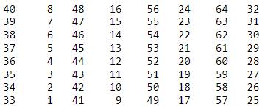
DES algorithm
(8). After the 16th round, Swap L₁₆ and R₁₆.
(9). Apply final permutation using IP⁻¹ table .
R₁₆L₁₆ = 00001010 01001100 11011001 10010101 01000011 01000010 00110010 00110100
IP⁻¹ = 10000101 11101000 00010011 01010100 00001111 00001010 10110100 00000101
This is the encrypted form of
M = 0123456789ABCDEF
C = 85E813540F0AB405
Notes:
Decryption is simply the inverse of encryption, following the same steps as above, but reversing the order in which the subkeys are applied.

Slide 45
Versions of DES
Double DES (2DES)
Triple DES (3DES)
Simplified DES (S-DES)

Slide 46
Double DES
DES has been broken in 1998
One proposed solution: double DES.
Double DES is a encryption technique which uses two instance of DES on same plain text. In both instances it uses different keys to encrypt the plain text. The 64 bit plain text goes into first DES instance which then converted into a 64 bit middle text using the first key and then it goes to second DES instance which gives 64 bit cipher text by using second key.

Slide 47
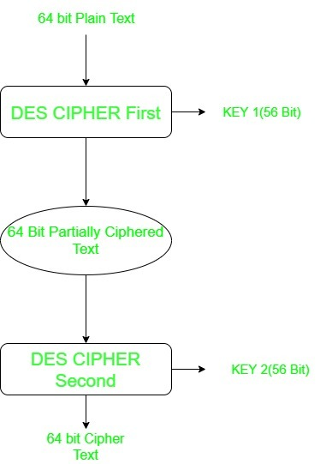
Double DES
Apply DES twice using two keys, K1 and K2.
– Encryption: C = EK2 [ EK1 [ P ] ]
– Decryption: P = DK2 [ DK1 [ C ] ]
This leads to a 2x56=112 bit key, so it is more secure than DES.

Slide 48
Triple DES Algorithm
Triple DES is a encryption technique which uses three instance of DES on same plain text. It uses three different types of keys: two keys are same and one is different.
It encrypts with the first key (k1), decrypts using the second key (k2), then encrypts with the third key (k3). There is also a two-key variant, where k1 and k3 are the same keys.
Notes:
We discuss timing attacks in more detail in Part Two, as they relate to public-key
algorithms. However, the issue may also be relevant for symmetric ciphers. In essence,
a timing attack is one in which information about the key or the plaintext is obtained
by observing how long it takes a given implementation to perform decryptions on
various ciphertexts. A timing attack exploits the fact that an encryption or decryption
algorithm often takes slightly different amounts of time on different inputs. [HEVI99]
reports on an approach that yields the Hamming weight (number of bits equal to one)
of the secret key. This is a long way from knowing the actual key, but it is an intriguing
first step. The authors conclude that DES appears to be fairly resistant to a successful
timing attack but suggest some avenues to explore. Although this is an interesting line
of attack, it so far appears unlikely that this technique will ever be successful against
DES or more powerful symmetric ciphers such as triple DES and AES.

Slide 49
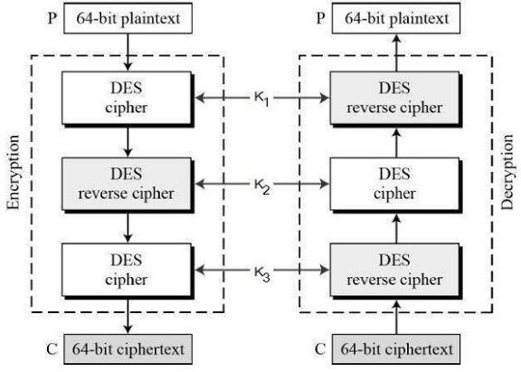
Triple DES Algorithm
The encryption-decryption process is as follows −
Encrypt the plaintext blocks using single DES with key K₁.
Now decrypt the output of step 1 using single DES with key K₂.
Finally, encrypt the output of step 2 using single DES with key K₃.
The output of step 3 is the ciphertext.
Decryption of a ciphertext is a reverse process. User first decrypt using K_{3,} then encrypt with K_{2,} and finally decrypt with K₁.
Notes:
We discuss timing attacks in more detail in Part Two, as they relate to public-key
algorithms. However, the issue may also be relevant for symmetric ciphers. In essence,
a timing attack is one in which information about the key or the plaintext is obtained
by observing how long it takes a given implementation to perform decryptions on
various ciphertexts. A timing attack exploits the fact that an encryption or decryption
algorithm often takes slightly different amounts of time on different inputs. [HEVI99]
reports on an approach that yields the Hamming weight (number of bits equal to one)
of the secret key. This is a long way from knowing the actual key, but it is an intriguing
first step. The authors conclude that DES appears to be fairly resistant to a successful
timing attack but suggest some avenues to explore. Although this is an interesting line
of attack, it so far appears unlikely that this technique will ever be successful against
DES or more powerful symmetric ciphers such as triple DES and AES.

Slide 50
Timing attacks
In cryptography, timing attacks are a class of malicious attacks against a product where the length of time that your application takes to perform a task leaks some information.
For example, an application that takes in an email and password to check. If there is no user with a provided email address, returns an error in 5ms, but when given a valid email for a user with an incorrect password, returns an error in 500ms.
Notes:
We discuss timing attacks in more detail in Part Two, as they relate to public-key
algorithms. However, the issue may also be relevant for symmetric ciphers. In essence,
a timing attack is one in which information about the key or the plaintext is obtained
by observing how long it takes a given implementation to perform decryptions on
various ciphertexts. A timing attack exploits the fact that an encryption or decryption
algorithm often takes slightly different amounts of time on different inputs. [HEVI99]
reports on an approach that yields the Hamming weight (number of bits equal to one)
of the secret key. This is a long way from knowing the actual key, but it is an intriguing
first step. The authors conclude that DES appears to be fairly resistant to a successful
timing attack but suggest some avenues to explore. Although this is an interesting line
of attack, it so far appears unlikely that this technique will ever be successful against
DES or more powerful symmetric ciphers such as triple DES and AES.

Slide 51
Timing attacks
One in which information about the key or the plaintext is obtained by observing how long it takes to perform decryptions on various ciphertexts
Exploits the fact that an encryption or decryption algorithm often takes slightly different amounts of time on different inputs
So far it appears unlikely that this technique will ever be successful against DES or more powerful symmetric ciphers such as triple DES and AES
Notes:
We discuss timing attacks in more detail in Part Two, as they relate to public-key
algorithms. However, the issue may also be relevant for symmetric ciphers. In essence,
a timing attack is one in which information about the key or the plaintext is obtained
by observing how long it takes a given implementation to perform decryptions on
various ciphertexts. A timing attack exploits the fact that an encryption or decryption
algorithm often takes slightly different amounts of time on different inputs. [HEVI99]
reports on an approach that yields the Hamming weight (number of bits equal to one)
of the secret key. This is a long way from knowing the actual key, but it is an intriguing
first step. The authors conclude that DES appears to be fairly resistant to a successful
timing attack but suggest some avenues to explore. Although this is an interesting line
of attack, it so far appears unlikely that this technique will ever be successful against
DES or more powerful symmetric ciphers such as triple DES and AES.

Slide 52
Strength of DES
56-bit keys have 2⁵⁶ = 7.2 x 10¹⁶ values
brute force search looks hard.
DES is robust against timing attacks
Notes:
We discuss timing attacks in more detail in Part Two, as they relate to public-key
algorithms. However, the issue may also be relevant for symmetric ciphers. In essence,
a timing attack is one in which information about the key or the plaintext is obtained
by observing how long it takes a given implementation to perform decryptions on
various ciphertexts. A timing attack exploits the fact that an encryption or decryption
algorithm often takes slightly different amounts of time on different inputs. [HEVI99]
reports on an approach that yields the Hamming weight (number of bits equal to one)
of the secret key. This is a long way from knowing the actual key, but it is an intriguing
first step. The authors conclude that DES appears to be fairly resistant to a successful
timing attack but suggest some avenues to explore. Although this is an interesting line
of attack, it so far appears unlikely that this technique will ever be successful against
DES or more powerful symmetric ciphers such as triple DES and AES.

Slide 53
Simplified DES
Simplified DES was developed for educational purposes and it was not intended as a secure algorithm.
It uses a small key size of 10 bits only.
The block size is also small (8 bits only).
The small key size make it very vulnerable to brute force attack.

Slide 54
Simplified DES
S-DES | DES
Block of size 8 | Block of size 64
10-bit key: 2 x 8-bit round key | 56-bit key: 16 x 48-bit round key
Round function operates on 4 bits | Round function operates on 32 bits
2 S-boxes | 8 S-boxes
2 rounds | 16 rounds

Slide 55
Simplified DES
S-DES encryption The encryption algorithm involves five functions:
An initial permutation (IP)
A complex function labeled f_{k}, which involves both permutation and substitution operations and depends on a key input
A simple permutation function that switches the two halves of the data
The function f_{k} again
A permutation function that is the inverse of the initial permutation (IP⁻¹).

Slide 56
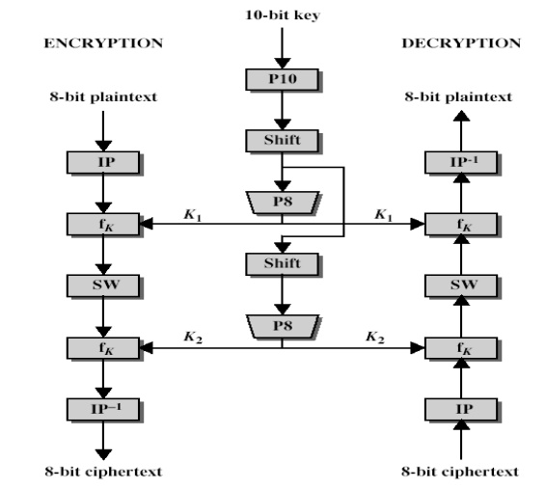
Simplified DES

Slide 57
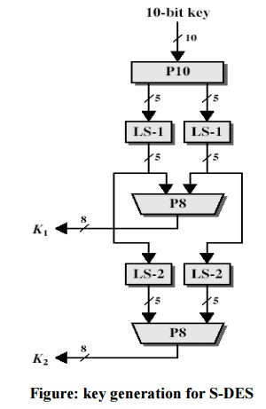
Simplified DES

Slide 58
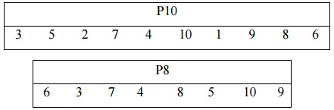
Simplified DES-Encryption
Let the 10-bit key is 1100011110, and the plaintext is 00101000.
Step1. Key generation:
The keys k1 and k2 are derived using the functions P10, Shift, and P8, as follows:

Slide 59
Simplified DES-Encryption
Steps | Bit # | 1 2 3 4 5 | 6 7 8 9 10
 | K | 1 1 0 0 0 | 1 1 1 1 0
1. P Choice 1 | P10(K)
2. Left shift | Shift(P10(K))
3. P Choice 2 | P8(Shift(P10(K)))

Slide 60
Simplified DES-Encryption
Steps | Bit # | 1 2 3 4 5 | 6 7 8 9 10
 | K | 1 1 0 0 0 | 1 1 1 1 0
1. P Choice 1 | K0→P10(K) | 0 0 1 1 0 | 0 1 1 1 1
2. Left shift | Shift(P10(K)) | 0 1 1 0 0 | 1 1 1 1 0
3. P Choice 2 | K1→P8(Shift(P10(K))) | 1 1 1 0 1 | 0 0 1

Slide 61
Simplified DES-Encryption
Steps | Bit # | 1 2 3 4 5 | 6 7 8 9 10
 | K | 1 1 0 0 0 | 1 1 1 1 0
1. P Choice 1 | K0→P10(K) | 0 0 1 1 0 | 0 1 1 1 1
2. Left shift | Shift(P10(K)) | 0 1 1 0 0 | 1 1 1 1 0
3. P Choice 2 | K1→P8(Shift(P10(K))) | 1 1 1 0 1 | 0 0 1
2. Left shift | Shift2(Shift(P10(K)))
3. P Choice 2 | K2→P8(Shift2(K))

Slide 62
Simplified DES-Encryption
Steps | Bit # | 1 2 3 4 5 | 6 7 8 9 10
 | K | 1 1 0 0 0 | 1 1 1 1 0
1. P Choice 1 | K0→P10(K) | 0 0 1 1 0 | 0 1 1 1 1
2. Left shift | Shift(P10(K)) | 0 1 1 0 0 | 1 1 1 1 0
3. P Choice 2 | K1→P8(Shift(P10(K))) | 1 1 1 0 1 | 0 0 1
2. Left shift | Shift2(Shift(P10(K))) | 1 0 0 0 1 | 1 1 0 1 1
3. P Choice 2 | K2→P8(Shift2(K)) | 1 0 1 0 0 | 1 1 1

Slide 63
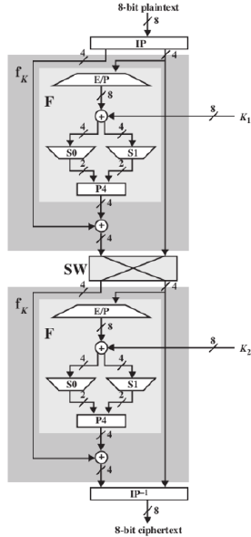
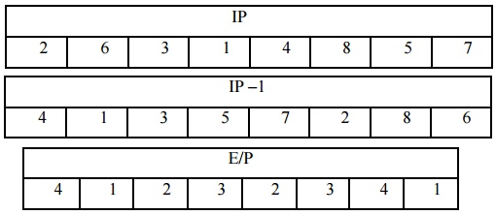
Simplified DES-Encryption
Stage1. Key generation:
K1= 11101001
K2=10100111
Stage2. Encode 8-bit block of plaintext:
L_{n} = R_{n-1} R_{n} = L_{n-1} + f(R_{n-1},K_{n})

Slide 64
Simplified DES-Encryption
Stage2. Encode 8-bit block of data:
PT=00101000
Steps | Bit # | 1 2 3 4 | 5 6 7 8
 | PT | 0 0 1 0 | 1 0 0 0
1. Initial P | IP(PT) | 0 0 1 0 | 0 0 1 0

Slide 65
Simplified DES-Encryption
Step2. Encode 8-bit block of data:
PT=00101000
L_{n} = R_{n-1} R_{n} = L_{n-1} + f(R_{n-1},K_{n})
Steps | Bit # | 1 2 3 4 | 5 6 7 8
 | PT | 0 0 1 0 | 1 0 0 0
1. Initial P | IP(PT) | 0 0 1 0 | 0 0 1 0
2. Split L & R | L₀R₀ | 0 0 1 0 | 0 0 1 0
2. Expansion | E(R) | 0 0 0 1 | 0 1 0 0
 | K1 | 1 1 1 0 | 1 0 0 1
3. XOR k & E(R) | K ⊕ E(R) | 1 1 1 1 | 1 1 0 1

Slide 66
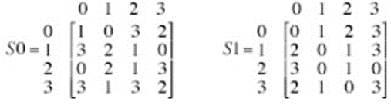
Simplified DES-Encryption
Step2. Encode 8-bit block of data:
Row#→ (b₁,b₄)→11→3
Col#→(b₂,b₃)→11→3
Steps | Bit # | 1 2 3 4 | 5 6 7 8
 | PT | 0 0 1 0 | 1 0 0 0
1. Initial P | IP(PT) | 0 0 1 0 | 0 0 1 0
2. Split L & R | L₀R₀ | 0 0 1 0 | 0 0 1 0
3. Expansion | E(R) | 0 0 0 1 | 0 1 0 0
 | K1 | 1 1 1 0 | 1 0 0 1
4. XOR k & E(R) | K ⊕ E(R) | 1 1 1 1 | 1 1 0 1
5. S-box Choice | S-Boxes(K ⊕ E(R)) | 1 0 0 0

Slide 67

Simplified DES-Encryption
Step2. Encode 8-bit block of data:
L_{n} = R_{n-1} R_{n} = L_{n-1} + f(R_{n-1},K_{n})
 | Bit # | 1 2 3 4 | 5 6 7 8
 | PT | 0 0 1 0 | 1 0 0 0
1. Initial P | IP(PT) | 0 0 1 0 | 0 0 1 0
2. Split L & R | L₀R₀ | 0 0 1 0 | 0 0 1 0
3. Expansion | E(R) | 0 0 0 1 | 0 1 0 0
 | K1 | 1 1 1 0 | 1 0 0 1
4. XOR k & E(R) | K ⊕ E(R) | 1 1 1 1 | 1 1 0 1
5. S-box Choice | S-Boxes(K ⊕ E(R)) | 1 0 0 0
6. Permutation | P4(S-Boxes(K ⊕ E(R))) | 0 0 0 1
7. XOR L & P | L ⊕ P4

Slide 68
Simplified DES-Encryption
Step2. Encode 8-bit block of data:
L₁ = R₀= 0010 R₁ = L₀ + f(R₀,K₁)= 0011
The output of the first round is: 0010 0011
 | Bit # | 1 2 3 4 | 5 6 7 8
 | PT | 0 0 1 0 | 1 0 0 0
1. Initial P | IP(PT) | 0 0 1 0 | 0 0 1 0
2. Split L & R | L₀R₀ | 0 0 1 0 | 0 0 1 0
3. Expansion | E(R) | 0 0 0 1 | 0 1 0 0
 | K1 | 1 1 1 0 | 1 0 0 1
4. XOR k & E(R) | K ⊕ E(R) | 1 1 1 1 | 1 1 0 1
5. S-box Choice | S-Boxes(K ⊕ E(R)) | 1 0 0 0
6. Permutation | P4(S-Boxes(K ⊕ E(R))) | 0 0 0 1
7. XOR L & P | L ⊕ P4 | 0 0 1 1

Slide 69
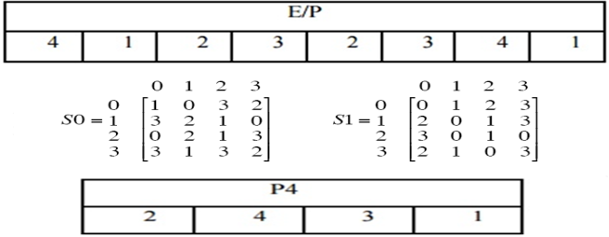
S-DES Encryption
Round 2:
L₂ = R₁= 0011 R₂ = L₁ + f(R₁,K₂)
The output of the first round is: 0010 0011
 | Bit # | 1 2 3 4 | 5 6 7 8
 | Round 1 | 0 0 1 0 | 0 0 1 1
2. Split L & R | L₁R₁ | 0 0 1 0 | 0 0 1 1
3. Expansion | E(R) | 1 0 0 1 | 0 1 1 0
 | K2 | 1 0 1 0 | 0 1 1 1
4. XOR k & E(R) | K ⊕ E(R) | 0 0 1 1 | 0 0 0 1
5. S-box Choice | S-Boxes(K ⊕ E(R)) | 1 0 1 0
6. Permutation | P4(S-Boxes(K ⊕ E(R))) | 0 0 1 1
7. XOR L & P | L ⊕ P4

Slide 70
S-DES Encryption
Round 2:
L₂ = R₁= 0011 R₂ = L₁ + f(R₁,K₂)
The output of the first round is: 0010 0011
 | Bit # | 1 2 3 4 | 5 6 7 8
 | Round 1 | 0 0 1 0 | 0 0 1 1
2. Split L & R | L₁R₁ | 0 0 1 0 | 0 0 1 1
3. Expansion | E(R) | 1 0 0 1 | 0 1 1 0
 | K2 | 1 0 1 0 | 0 1 1 1
4. XOR k & E(R) | K ⊕ E(R) | 0 0 1 1 | 0 0 0 1
5. S-box Choice | S-Boxes(K ⊕ E(R)) | 1 0 1 0
6. Permutation | P4(S-Boxes(K ⊕ E(R))) | 0 0 1 1
7. XOR L & P | L ⊕ P4 | 0 0 0 1
 | Round 2 | 0 0 1 1 | 0 0 0 1

Slide 71

S-DES Encryption
Swap and Inverse Permutation:
The cipher text is 1000 1010
Steps | Bit # | 1 2 3 4 | 5 6 7 8
8. Swap | RL | 0 0 0 1 | 0 0 1 1
9. Inverse P | IP⁻¹(RL) | 1 0 0 0 | 1 0 1 0

Slide 72
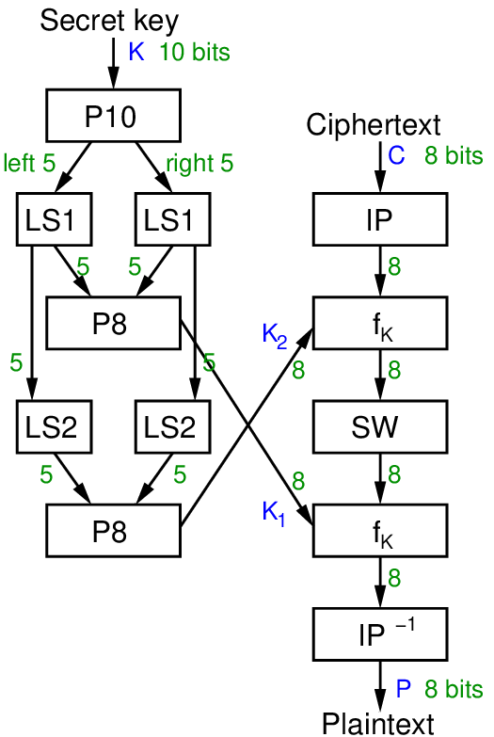
Simplified DES-Decryption
Let the 10-bit key is 1100101001, and the ciphertext is 00011001. Decrypt the ciphertext to get the original message.
Step1. Key generation.
Stage2. Decode 8-bit block of ciphertext.

Slide 73
Simplified DES-Decryption
Steps | Bit # | 1 2 3 4 5 | 6 7 8 9 10
 | K | 1 1 0 0 1 | 0 1 0 0 1
1. P Choice 1 | K0→P10(K)
2. Left shift | Shift(P10(K))
3. P Choice 2 | K1→P8(Shift(P10(K)))
2. Left shift | Shift2(Shift(P10(K)))
3. P Choice 2 | K2→P8(Shift2(K))

Slide 74
Simplified DES-Decryption
Steps | Bit # | 1 2 3 4 5 | 6 7 8 9 10
 | K | 1 1 0 0 1 | 0 1 0 0 1
1. P Choice 1 | K0→P10(K) | 0 1 1 1 0 | 1 1 0 0 0
2. Left shift | Shift(P10(K)) | 1 1 1 0 0 | 1 0 0 0 1
3. P Choice 2 | K1→P8(Shift(P10(K))) | 1 1 0 0 0 | 0 1 0
2. Left shift | Shift2(Shift(P10(K))) | 1 0 0 1 1 | 0 0 1 1 0
3. P Choice 2 | K2→P8(Shift2(K)) | 0 0 0 1 1 | 1 0 1

Slide 75
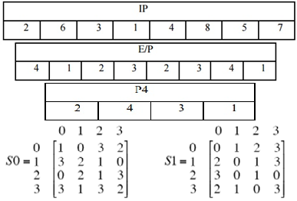
S-DES Decryption
Step2. Decode 8-bit block of data:
CT=00011001
K1= 11000010
K2=00011101
Steps | Bit # | 1 2 3 4 | 5 6 7 8
 | PT | 0 0 0 1 | 1 0 0 1
1. Initial P | IP(PT)
2. Split L & R | L₀R₀
3. Expansion | E(R)
 | K2
4. XOR k & E(R) | K ⊕ E(R)
5. S-box Choice | S-Boxes(K ⊕ E(R))
6. Permutation | P4(S-Boxes(K ⊕ E(R)))
7. XOR L & P | L ⊕ P4

Slide 76
S-DES Decryption
Step2. Decode 8-bit block of data:
CT=00011001
K1= 11000010
K2=00011101
Steps | Bit # | 1 2 3 4 | 5 6 7 8
 | PT | 0 0 0 1 | 1 0 0 1
1. Initial P | IP(PT) | 0 0 0 0 | 1 1 1 0
2. Split L & R | L₀R₀ | 0 0 0 0 | 1 1 1 0
3. Expansion | E(R) | 0 1 1 1 | 1 1 0 1
 | K2 | 0 0 0 1 | 1 1 0 1
4. XOR k & E(R) | K ⊕ E(R) | 0 1 1 0 | 0 0 0 0
5. S-box Choice | S-Boxes(K ⊕ E(R)) | 1 0 0 0
6. Permutation | P4(S-Boxes(K ⊕ E(R))) | 0 0 0 1
7. XOR L & P | L ⊕ P4 | 0 0 0 1
The output of the first round is: 1110 0001

Slide 77
S-DES Decryption
Step2. Decode 8-bit block of data:
CT=00011001
K1= 11000010
K2=00011101
Steps | Bit # | 1 2 3 4 | 5 6 7 8
 | Round1 | 1 1 1 0 | 0 0 0 1
2. Split L & R | L₀R₀
3. Expansion | E(R)
 | K1
4. XOR k & E(R) | K ⊕ E(R)
5. S-box Choice | S-Boxes(K ⊕ E(R))
6. Permutation | P4(S-Boxes(K ⊕ E(R)))
7. XOR L & P | L ⊕ P4

Slide 78
S-DES Decryption
Step2. Decode 8-bit block of data:
CT=00011001
K1= 11000010
K2=00011101
Steps | Bit # | 1 2 3 4 | 5 6 7 8
 | Round1 | 1 1 1 0 | 0 0 0 1
2. Split L & R | L₀R₀ | 1 1 1 0 | 0 0 0 1
3. Expansion | E(R) | 1 0 0 0 | 0 0 1 0
 | K1 | 1 1 0 0 | 0 0 1 0
4. XOR k & E(R) | K ⊕ E(R) | 0 1 0 0 | 0 0 0 0
5. S-box Choice | S-Boxes(K ⊕ E(R)) | 1 1 0 0
6. Permutation | P4(S-Boxes(K ⊕ E(R))) | 1 0 0 1
7. XOR L & P | L ⊕ P4 | 0 1 1 1
The output of the second round is: 0001 0111

Slide 79
S-DES Decryption
Swap and Inverse Permutation:
The original plaintext is 1010 0110
Steps | Bit # | 1 2 3 4 | 5 6 7 8
8. Swap | RL | 0 1 1 1 | 0 0 0 1
9. Inverse P | IP⁻¹(RL) | 1 0 1 0 | 0 1 1 0

Slide 80
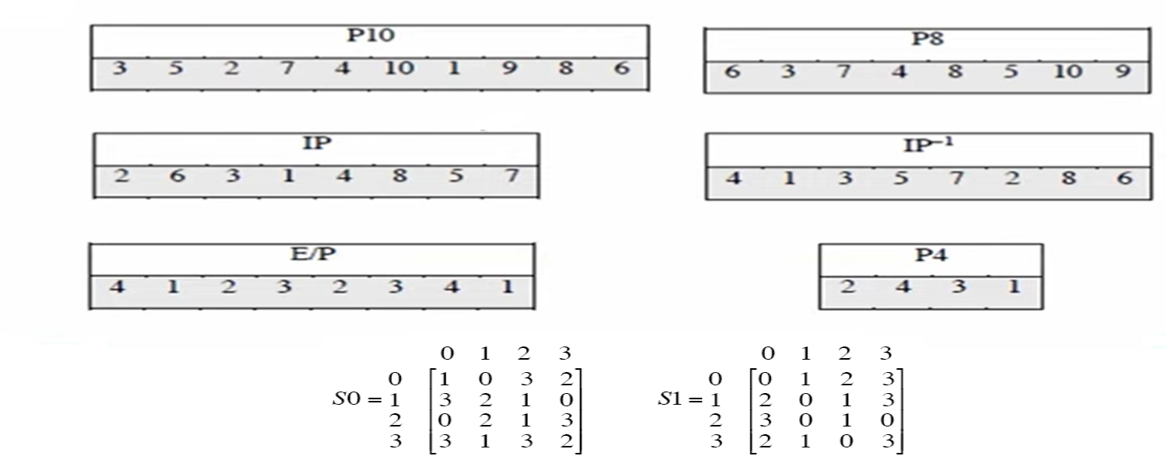
Homework
Encrypt the plaintext= 10111101 using S-DES algorithm with the encryption key k= 1010000010
Notes:
We discuss timing attacks in more detail in Part Two, as they relate to public-key
algorithms. However, the issue may also be relevant for symmetric ciphers. In essence,
a timing attack is one in which information about the key or the plaintext is obtained
by observing how long it takes a given implementation to perform decryptions on
various ciphertexts. A timing attack exploits the fact that an encryption or decryption
algorithm often takes slightly different amounts of time on different inputs. [HEVI99]
reports on an approach that yields the Hamming weight (number of bits equal to one)
of the secret key. This is a long way from knowing the actual key, but it is an intriguing
first step. The authors conclude that DES appears to be fairly resistant to a successful
timing attack but suggest some avenues to explore. Although this is an interesting line
of attack, it so far appears unlikely that this technique will ever be successful against
DES or more powerful symmetric ciphers such as triple DES and AES.

Slide 81
Summary
Traditional Block Cipher Structure
Stream ciphers
Block ciphers
Feistel cipher structure
Block cipher design principles
Number of rounds
Design of function F
Key generation algorithm
The Data Encryption Standard (DES)
Encryption
Decryption
The strength of DES
Use of 56-bit keys
Nature of the DES algorithm
Timing attacks

